Slide 1

Implementation Science Approaches to Integrating Cancer Survivorship Research into Practice and Policy: Models, Methods, and Measures
Russell E. Glasgow, Ph.D.
Deputy Director,
Implementation Science Team
Division of Cancer Control and Population Sciences
U.S. DEPARTMENT OF HEALTH AND HUMAN SERVICES
National Institutes
of Health
June 14, 2012

Slide 2

NCI Implementation Science
Team Vision
To achieve the rapid integration of scientific evidence, practice, and policy, with the ultimate goal of improving the impact of research on cancer outcomes and promoting health across individual, organizational and community levels.

Slide 3
Models, Methods and Measures for Survivorship from Implementation Science
Models
Methods
Measures
Discussion
Models: T0-T4 and Key Lessons Learned
Methods:
    Types of Evidence Needed
    RE-AIM Framework
    Measures:
    Care Planning
    D and I measures (context, implementation, costs)

Slide 4

D&I Definitions (aka KT)
Models
Methods
Measures
Discussion
“Dissemination is the targeted distribution of information and intervention materials to a specific public health or clinical practice audience. The intent is to spread knowledge and the associated evidence-based interventions.” (scale-up)
“Implementation is the use of strategies to adopt and integrate evidence-based health interventions and change practice patterns within specific….settings”

Slide 5
Dissemination and Implementation Research Characteristics
Models
Methods
Measures
Discussion
Contextual
Complex
Multi-component programs and policies
Non-linear
Transdisciplinary
Multi-level and multi-method
Addresses “wicked”, messy, important problems
Brownson, R, Colditz, G, and Proctor, E (Eds.). Dissemination and Implementation Research in Health. New York: Oxford University Press, 2012.
Glasgow, R. E. & Chambers, D. Clin Transl Sci 2012:5, 48-55

Slide 6
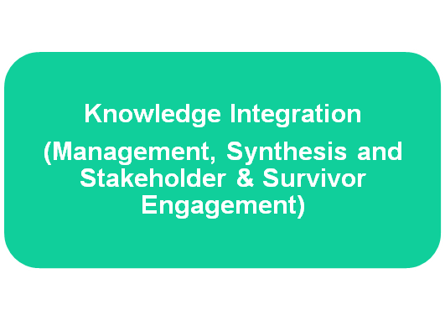
The Translational Science Process for Survivorship
T1
Scientific Discovery
(preclinical,
epidemiology
mechanism studies)
Tests of promising
Interventions
(Phase I, II, &
III trials)
T0
T2
Survivor Population
Health; Disease
Burden; Public health
impact (Surveillance
indicators)
Evidence based
Recommendations
& policies
(Guidelines)
T4
T3
Implementation into
Practice,
Organizations, and
Communities
Modified from Khoury MJ et al; Am J Epidemiol 2010; 172:517-524
Notes:
National Cancer Institute

Slide 7
Implications of T0-T4 model
Models
Methods
Measures
Discussion
Progress is not linear
Knowledge integration involves “knowing where we are going”; not getting stuck at T0-T2
There is “basic” research at each level of T0-T4
Need respect and convergence across methods, disciplines, and “stages” of research
Stakeholder involvement is essential—throughout

Slide 8

Most Common Type of Research?
Bench to Bookshelf

Slide 9
Abundance of D&I Models—61 at Least; But There are Key Common Points:
Models
Methods
Measures
Discussion
Context is critical
Begin with stakeholders—take their perspective
Design for dissemination—from beginning—cannot wait until the end
Need balance between fidelity to evidence-based program and adaptation to local setting

Slide 10
Key Common Points (cont.)
Models
Methods
Measures
Discussion
There is more than evidence needed for successful adoption, implementation and sustainability
D&I Science is a multi-level affair
Select the DESIGN and the MODEL that best fits your question—less important WHICH model than that you use it well
Need to focus on replication, relevance, transparency, and costs

Slide 11

Types of D & I Methods and Evidence Needed: 2R’s and “RCT”
Models
Methods
Measures
Discussion
Relevant
Rigorous and
Rapid
Cost informative
Transparent
Glasgow R, Annals of Behavioral Medicine, 2008, 35: 19-25.
Glasgow R, Chambers D. Clinical and Translational Science, 2012, 5(1):48-55
http://cancercontrol.cancer.gov/IS/

Slide 12
Relevant (Contextual and Practical)
Models
Methods
Measures
Discussion
Relevant to stakeholders (patients/family, clinicians, administrators, policy makers)
Relevant samples—representative of real- world, including patients with co-morbid conditions
Relevant settings—similar to those in practice (not just the most advanced and well resourced)
Relevant staff—including those who have other duties and competing demands

Slide 13
Why is D&I Relevant to Survivorship? Ultimate Impact of “Evidence Based Intervention X”
Models
Methods
Measures
Discussion
Dissemination | Concept | % Impacted
50% of Clinics Use | Adoption | 50%
50% of Practitioners Recommend | Adoption | 25%
50% of Patients Accept Recommendation/Attempt Change | Reach | 12.5%
50% Follow Regimen Correctly | Implementation | 6.2 %
50% of Those Implementing Correctly have Substantial Benefit | Effectiveness | 3.1%
50% Continue to Adhere/Benefit After 6 Months | Maintenance | 1.6%

Slide 14
Moral of the Story?
Models
Methods
Measures
Discussion
“Focus on the Denominator”
(not just the numerator)
Each step of the dissemination sequence or each “RE-AIM”
dimension is important
www.re-aim.org

Slide 15
RE-AIM Realist* Question:
Models
Methods
Measures
Discussion
What percent and types of patients are Reached;
For whom among them is the intervention Effective; in improving what outcomes;
In what percent and types of settings and staff is this approach Adopted;
How consistently are different parts of it Implemented at what cost to different parties;
And how well are the intervention components and their effects Maintained?
*Pawson R, et al. J Health Serv Res Policy 2005;10(S1):S21-S39.
Gaglio B, Glasgow RE. Evaluation approaches…In: Brownson R, Colditz G, Proctor E,
(Eds). Dissemination and implementation research in health: Translating science
to practice. New York: Oxford University Press; 2012. Pages 327-356.

Slide 16
RE-AIM Survivorship Care Plan (SCP) Example:
Models
Methods
Measures
Discussion
In what percent and types of patients are SCPs Received;
For whom among them is the intervention Effective; in improving what outcomes; what broader effects and negative consequences?
Among what percent and types of settings and practitioners are SCPs Adopted;
How consistently are different parts of SCPs Implemented across different settings, clinicians, and patient subgroups, and at what cost;
And how well is the SCP program and its effects Maintained?

Slide 17
Rigorous….and a Word about RCTs
Models
Methods
Measures
Discussion
Address most likely challenges to validity and conclusions for THAT question
Both external and internal validity are important
Design should fit the question—NOT vice-versa¹
An RCT is not an RCT is not an RCT
CONSORT delineation of pragmatic trials is an important advance²
RCT is not the only design that is experimental—and it does NOT guarantee causality^{3,4}
¹ Mercer S et al. Amer J Prev Med, 2007; 3:, 139-154.
² Thorpe et al. J Clin Epidem 2009; 62: 464–475, Can Med Ass J 2009; 180, E47-E57.
³ Kessler & Glasgow, Amer J Prev Med, 2011, 40, 637-644;
⁴ Cartwright BioSocieties, 2007, 2: 11-20.

Slide 18
Rapid Evidence
Models
Methods
Measures
Discussion
Need rapid learning research—especially for pressing issues such as obesity, HIV, explosion of health care spending, health inequities, and cancer survivorship
EMRs, and their potential enhancements, make possible “rapid learning health care systems”*
  Real-time data on millions of real-world patients in real-world health care settings, treated under usual conditions
  Institute of Medicine, A Foundation for Evidence-Driven Practice: A Rapid Learning System for Cancer Care, 2010. http://www.iom.edu/Reports/2010/A-Foundation-for-Evidence-Driven-Practice-A-Rapid-Learning-System-for-Cancer-Care.aspx
  Etheredge L et al, Health Affairs, Web Exclusive Collection, w107-w118, doi:10.1377/hlthaff.26.2.w107)

Slide 19
How to Evaluate Technologies that Outpace Research?
Models
Methods
Measures
Discussion
YouTube
iPhone
Android
iPad
2005
2006
2007
2008
2009
2010
2011
Grant Submit and Award
Development and Pilot Testing
Recruit and Randomize
Follow-ups
Analyze and Publish
William Riley, NHLBI and NCI

Slide 20
Cost Evidence
Models
Methods
Measures
Discussion
Replication costs and scalability costs are arguably most needed
Perspective— that of patient and adopting setting
Costs should be comprehensive and transparent
“One persons costs are another’s profits”
Should be harmonized and include costs frequently not counted that need to be—e.g., recruitment, overhead, training, preparation and supervision¹
Cost collection and cost-effectiveness analyses need not be overwhelming*--cost per incremental unit change
¹ Ritzwoller et al, Trans Behav Med, 2011, 1, 427-435.

Slide 21
Transparent Evidence on…..
Models
Methods
Measures
Discussion
Info needed to replicate or implement
Resources required—costs for patients and delivery setting perspectives
How were settings, clinicians, and patients selected—(who was excluded and why)
Adaptation—changes made to protocol, to intervention, to recruitment, etc.
Differences across settings

Slide 22
Future Evidence Needs and Opportunities—Keys to Advance Translation
Models
Methods
Measures
Discussion
Context—key factors that may moderate results
Scalability—potential to impact large numbers
Sustainability
Health equity impacts
Patient/citizen/consumer and community perspective and engagement throughout
Multi-level interactions, especially between policy and practice

Slide 23
All Models (and Methods) are Wrong…
Models
Methods
Measures
Discussion
….Some are useful
“To every complex question,
there is a simple answer…
and it is wrong.”
H. L. Mencken

Slide 24

Need for Better and Harmonized Measures in D&I and Survivorship Research
Models
Methods
Measures
Discussion
Most studies use their own measures, often unknown characteristics, and quite different measures same construct
Without standard or more harmonized measures, difficult to do reviews, syntheses, compare across studies
Are different purposes of measurement—e.g.:
  “Gold standard”—when this is primary focus for grant, need “best possible measure”, have staff to ensure quality
  “Practical measure”—for use in busy, low-
  resource settings; when one of a large
  set of measures; has to be brief and
  feasible

Slide 25
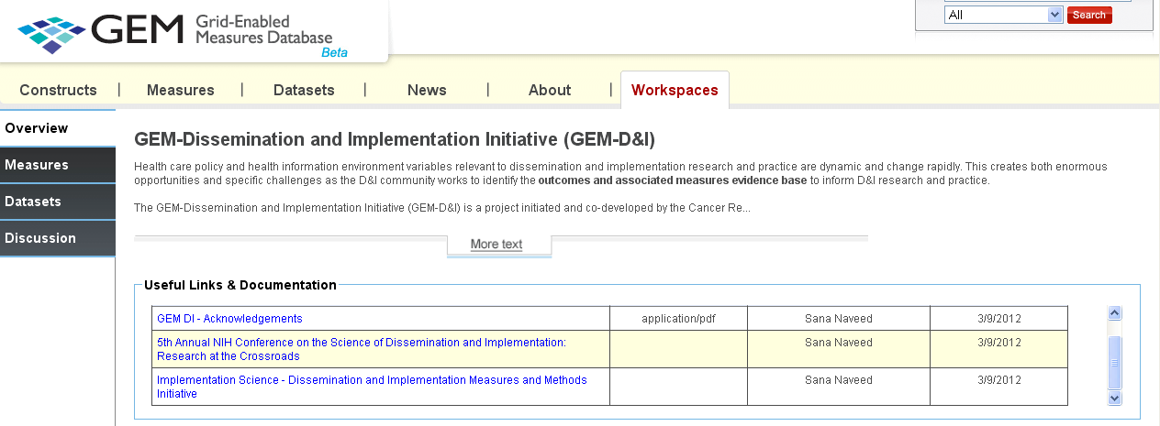


Care Planning and D&I Measures Initiatives
Models
Methods
Measures
Discussion
https://www.gem-beta.org/ (GEM Homepage)
http://cancercontrol.cancer.gov/IS/resources.html (IS Team Website)
http://dccps.nci.nih.gov/ocs/ (Office Cancer Survivorship)

Slide 26
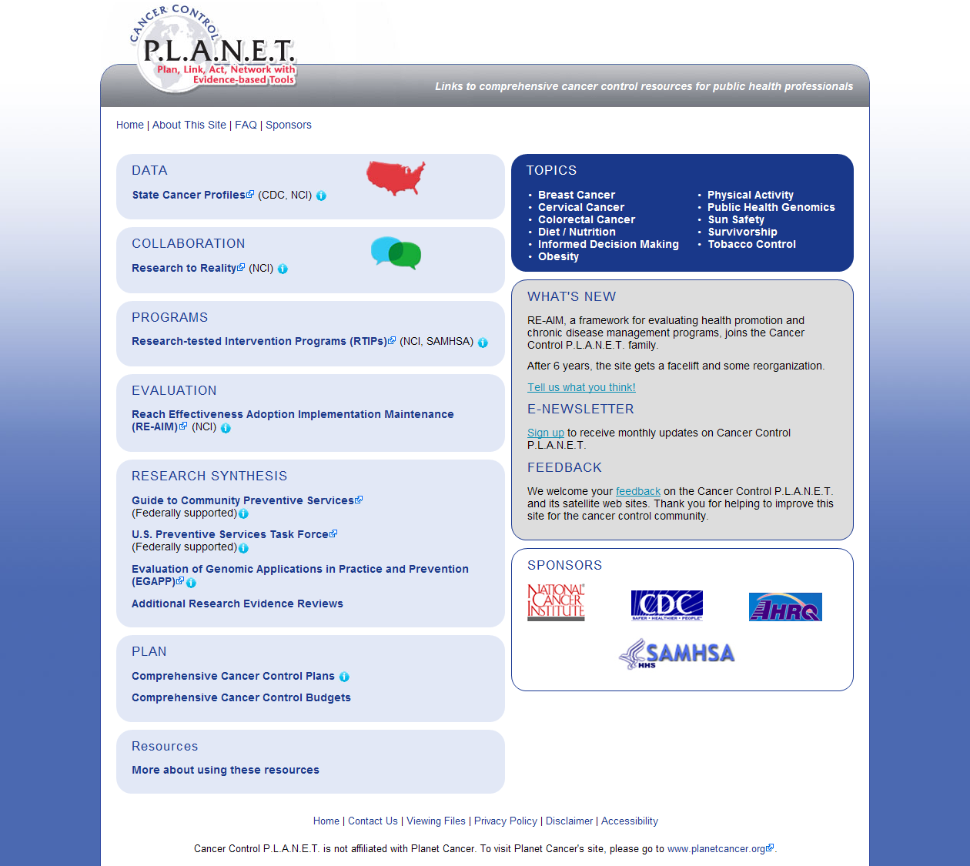
http://cancercontrolplanet.cancer.gov/

Slide 27
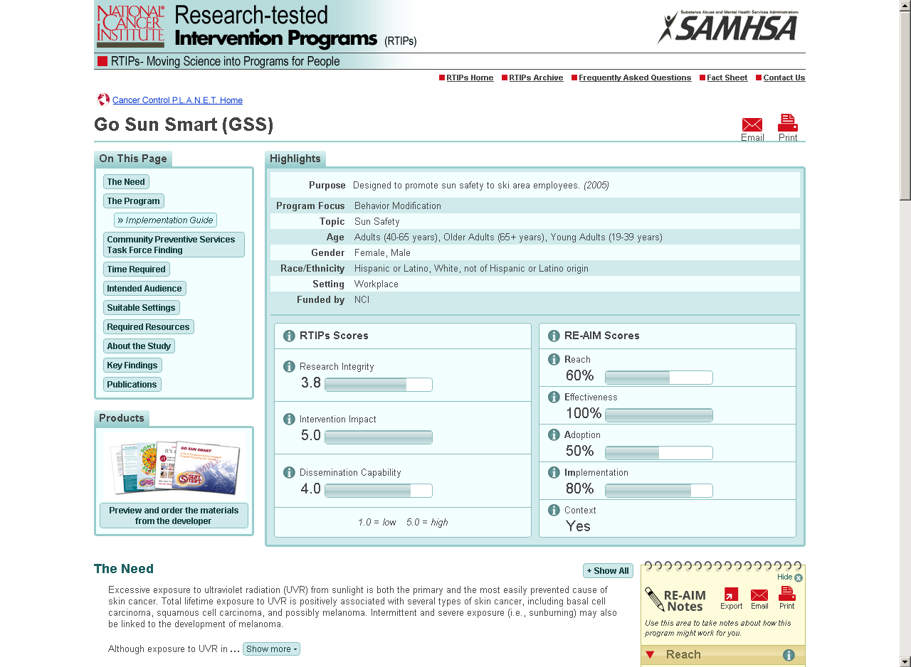

Slide 28

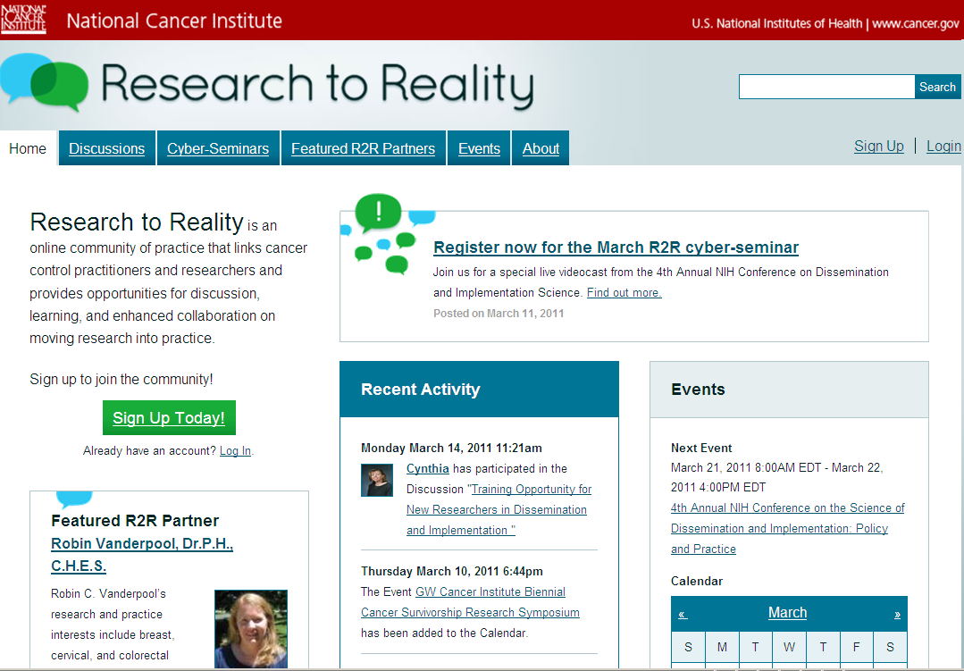
Research to Reality (R2R):
A Virtual Community of Practice
Models
Methods
Measures
Discussion
A dialogue between practitioners and
researchers on how to move evidence-based programs into practice
Launched February, 2011 (NCI)
  Linked to Cancer Control P.L.A.N.E.T. Step 2
Site Features:
  Monthly cyber-seminars
  Discussion forums
  Mentorship program
  An events calendar
  Featured partners
  Community profiles
https://ResearchtoReality.cancer.gov

Slide 29
The Translational Science Process for Survivorship
T1
Scientific Discovery
(preclinical,
epidemiology
mechanism studies)
Tests of promising
Interventions
(Phase I, II, &
III trials)
T0
T2
Survivor Population
Health; Disease
Burden; Public health
impact (Surveillance
indicators)
Evidence based
Recommendations
& policies
(Guidelines)
T4
T3
Implementation into
Practice,
Organizations, and
Communities
Modified from Khoury MJ et al; Am J Epidemiol 2010; 172:517-524
Notes:
National Cancer Institute

Slide 30
Take Home Points
Models
Methods
Measures
Discussion
There is a pressing need for a DIFFERENT type of research — “D&I” that translates more rapidly, and is more relevant to stakeholders
This field is still emerging, but there is agreement on key common points among different models of D&I research
There are many opportunities for this type of research, especially among networks including the Livestrong, VA, CRN, PBRN, cancer center, CTSA and community networks

Slide 31

Questions/Comments
Models
Methods
Measures
Discussion
Contact me: glasgowre@mail.nih.gov
IS Team Website: http://dccps.cancer.gov/is/

Slide 32
Linking Patient, Physician, and Community Programs
Informed Referrals and Support Opportunities
Patient Preferences and Status
Family, Friend, Peer Network
Health Care
System
Patient Citizen
Care Team
Informed, Supportive System
Engaged Patient
Informed, Supportive System
Successful PCP- Community Link
Promotion of targeted
Evidence-based Programs
Update on Progress
Informed Referrals
Feedback on Patient Progress
Evolving Evidence-Based Community Program and Resources
Larger Orgs/Networks
Community
Resource Program
Broader Multi-Level Context:
(intrapersonal/biological, interpersonal/family, organizational, policy, community/economic, social/environment/historical)

